Slide 1
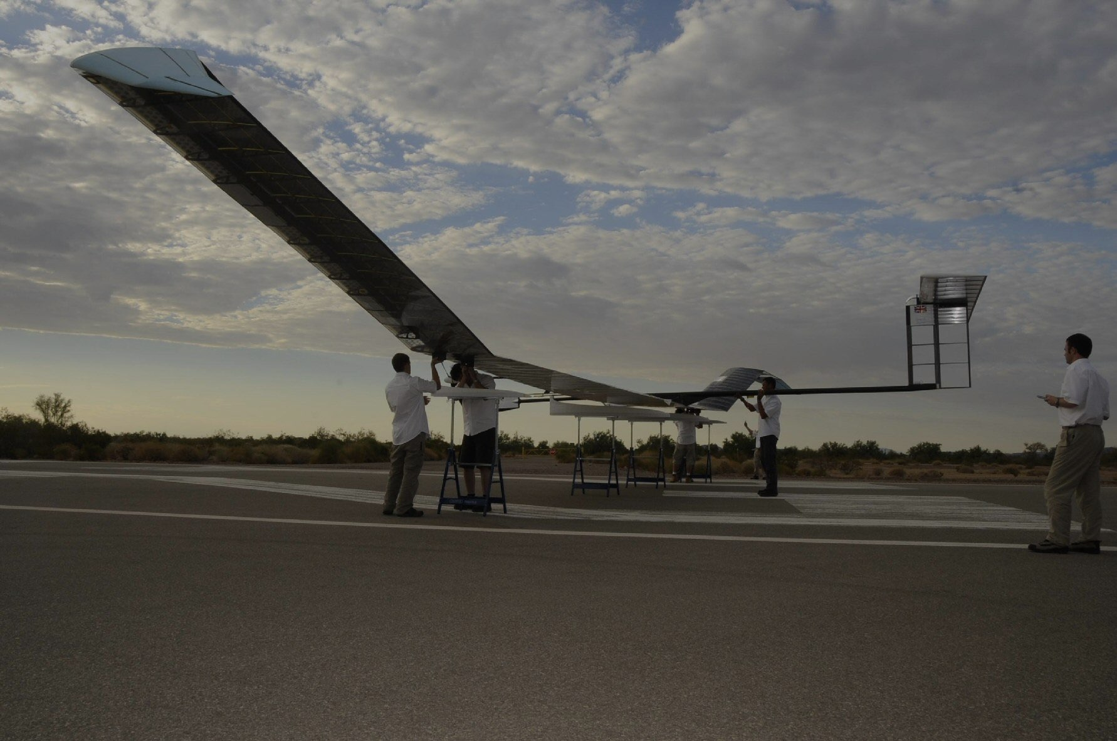
Airbus-SSTA HADR Presentation
Team Kestrel - Singapore Polytechnic
Notes:
Good morning, we are Team Kestral from Singapore Polytechnic. Today, we'll be presenting our solution for the Airbus-SSTA HADR challenge. We believe that solutions for disaster area communications available today can be vastly improved. We propose interfacing LEO and GSO Earth Imaging Satellites through the Zephyr Pseudo-Satellite to a device we carry day-in, day-out - our mobile phones.

Slide 2
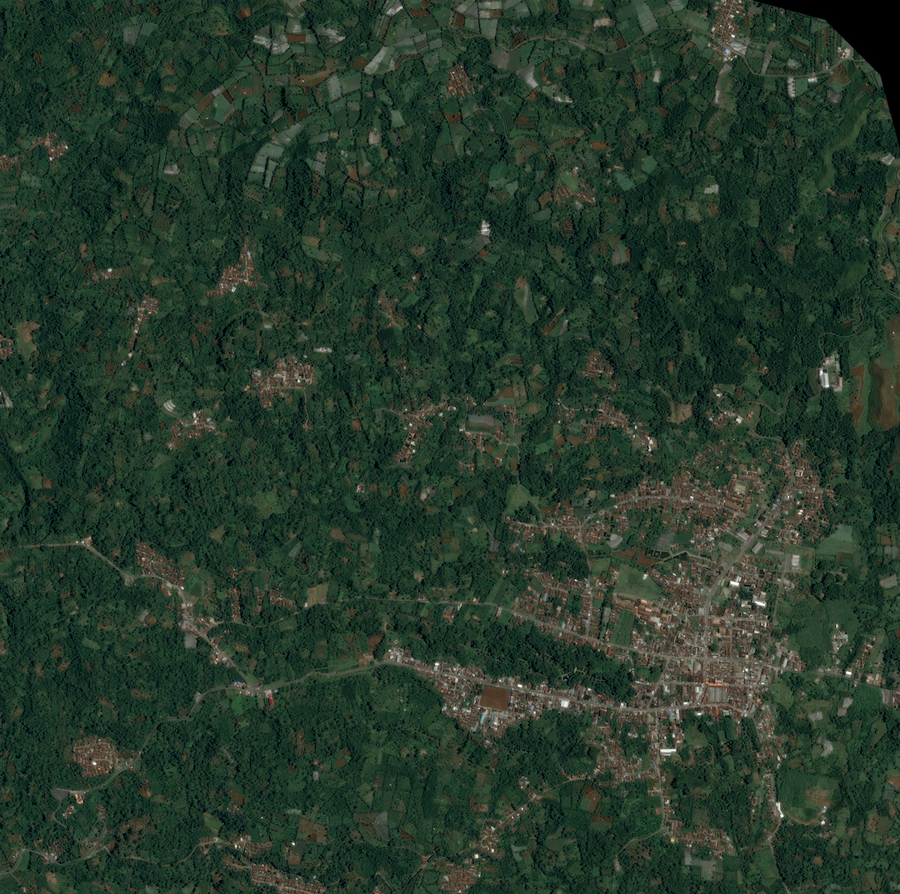
The Problem
Lack of efficient communication between workers
Time required to train workers on specialised equipment
Lack of infrastructure during the first days of a disaster
Notes:
The fact is that relief efforts are hard to coordinate at best. Large numbers of workers, plenty of assets to go around and everything is in continuous motion. It quickly becomes a mess if you use conventional devices like walkie talkies. Our mobile app tackles the fundamental issues that plague relief efforts: firstly, the lack of efficient and quick communication solutions between workers, the additional time needed to train and familiarise workers on specialised communications equipment, and finally the lack of communications infrastructure during the first hours or days of a disaster. All these issues exacerbate a crisis by slowing down search and rescue operations, potentially reducing survival rates.

Slide 3
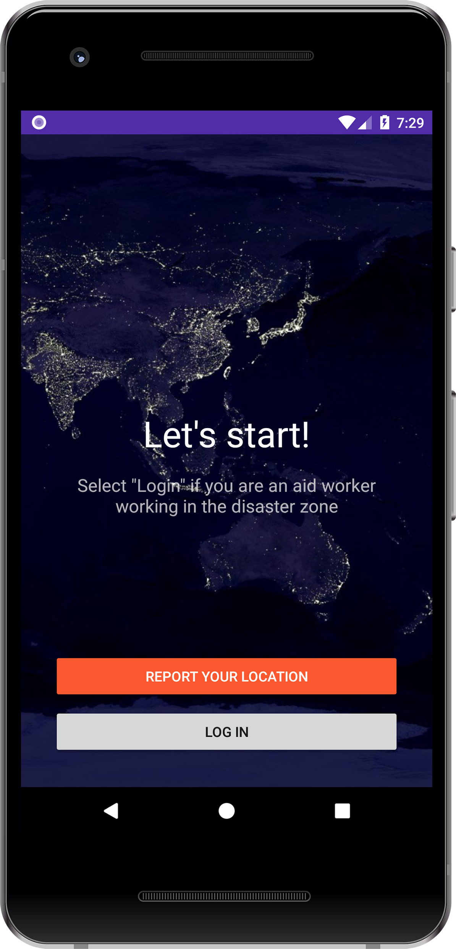
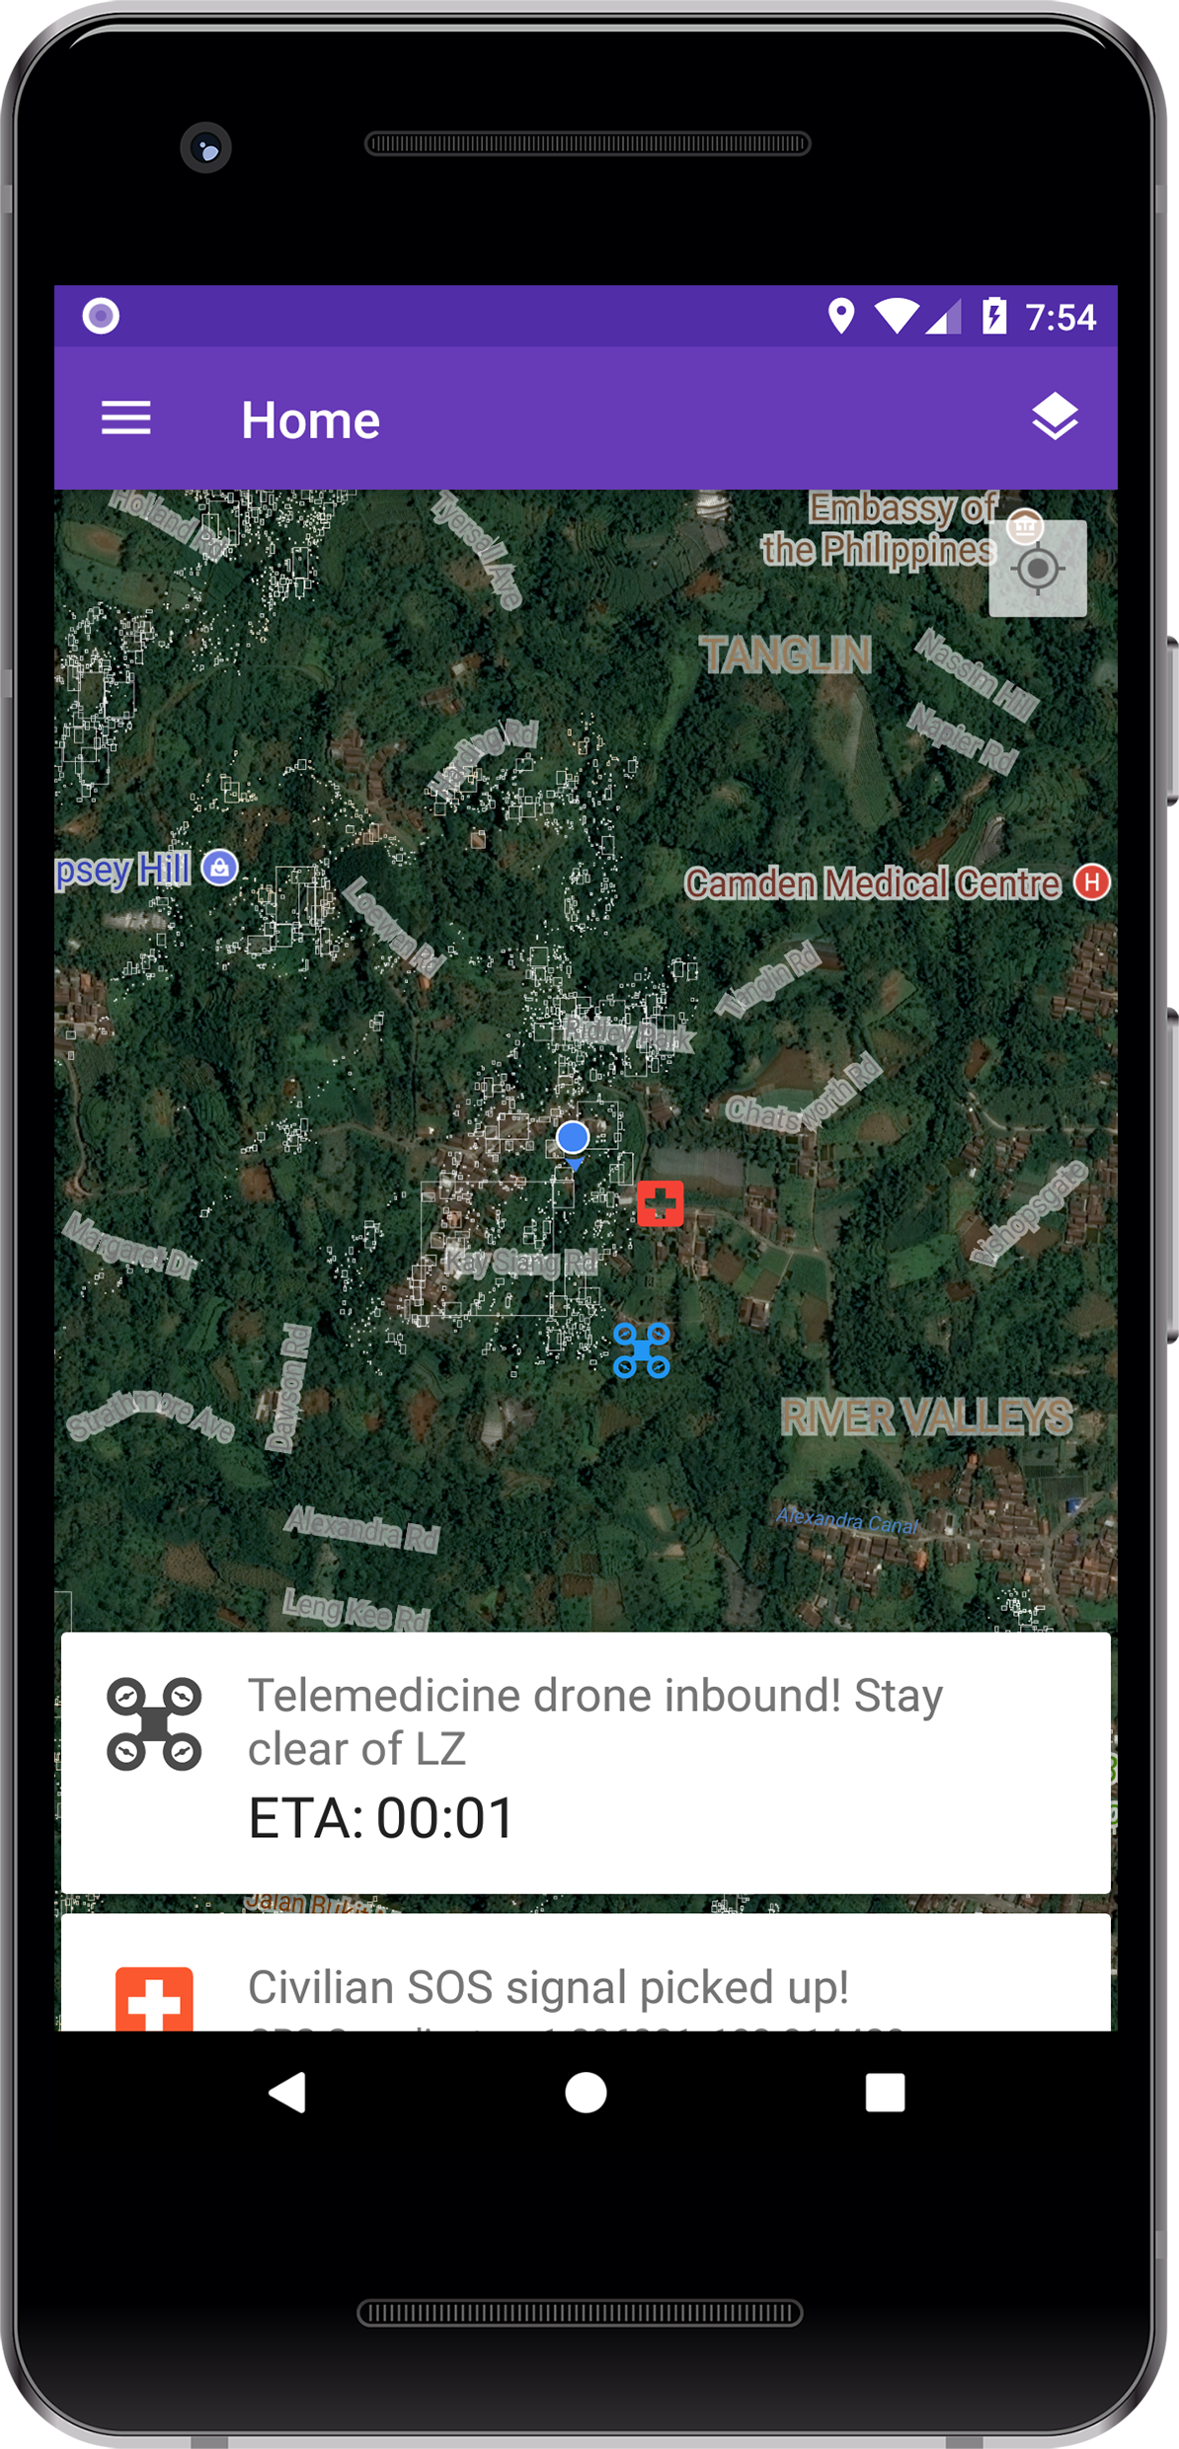
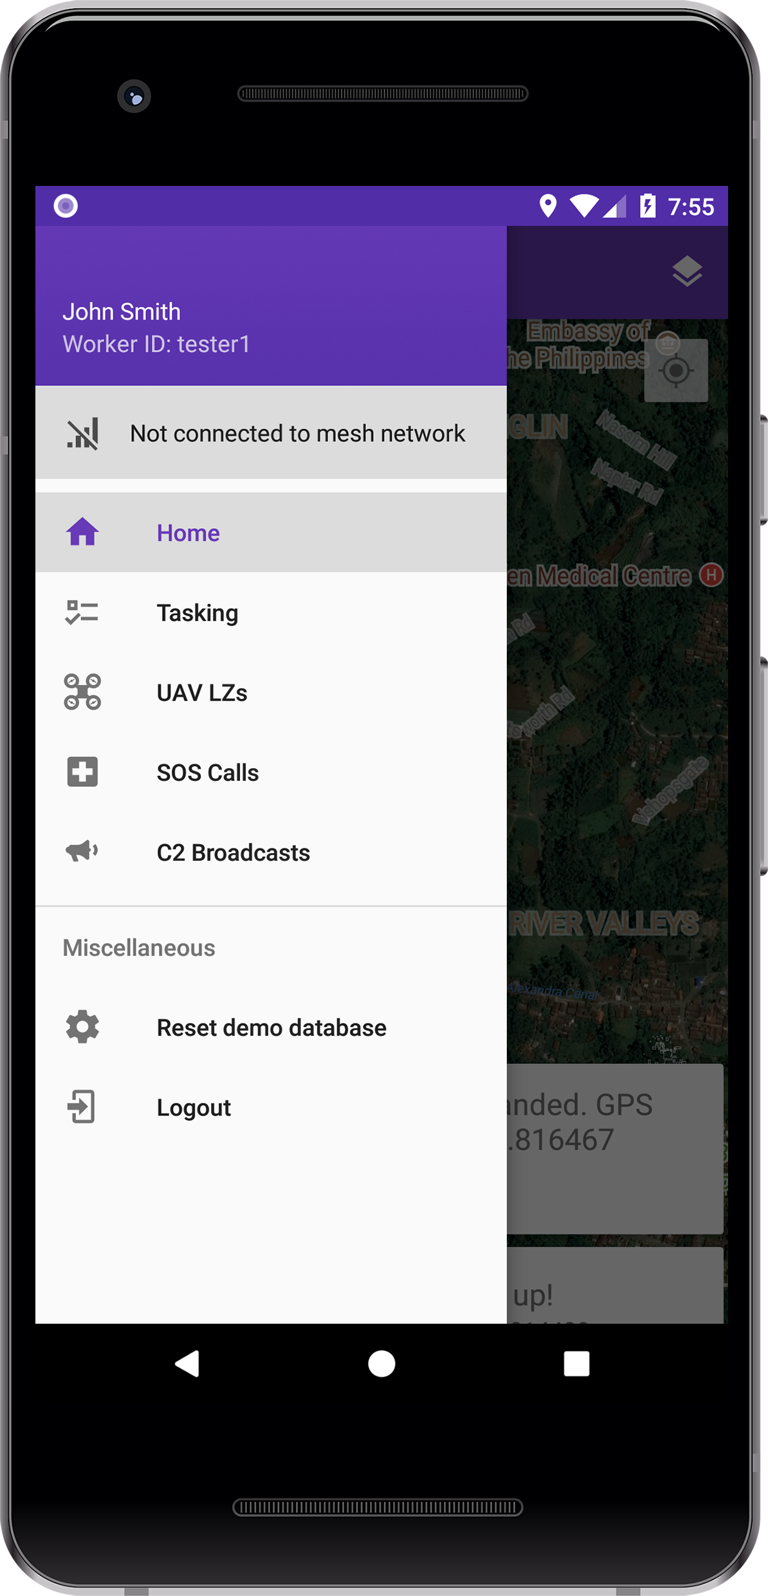
The solution
Notes:
This is our solution: an app centred around relief workers, providing them with a powerful communications solution to enable quicker response times and deploy manpower and aid exactly where they are needed.

Slide 4
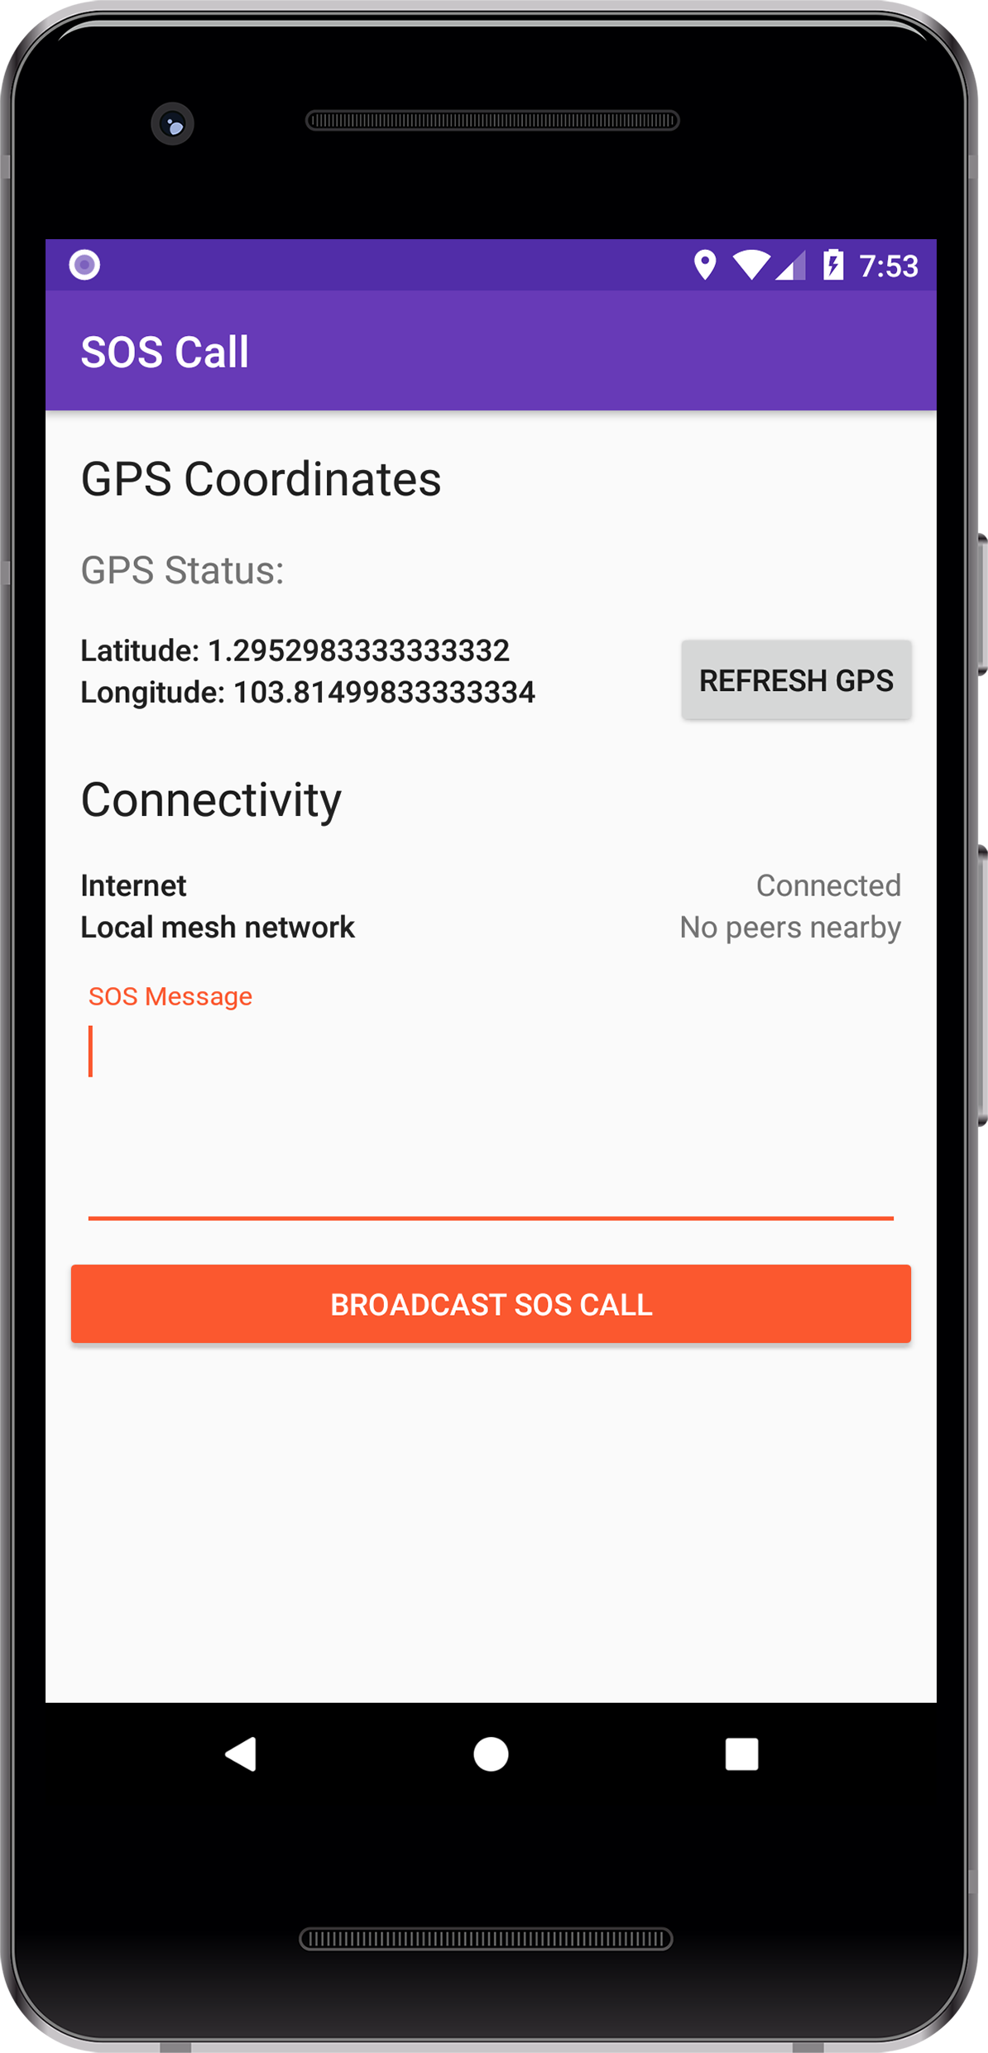
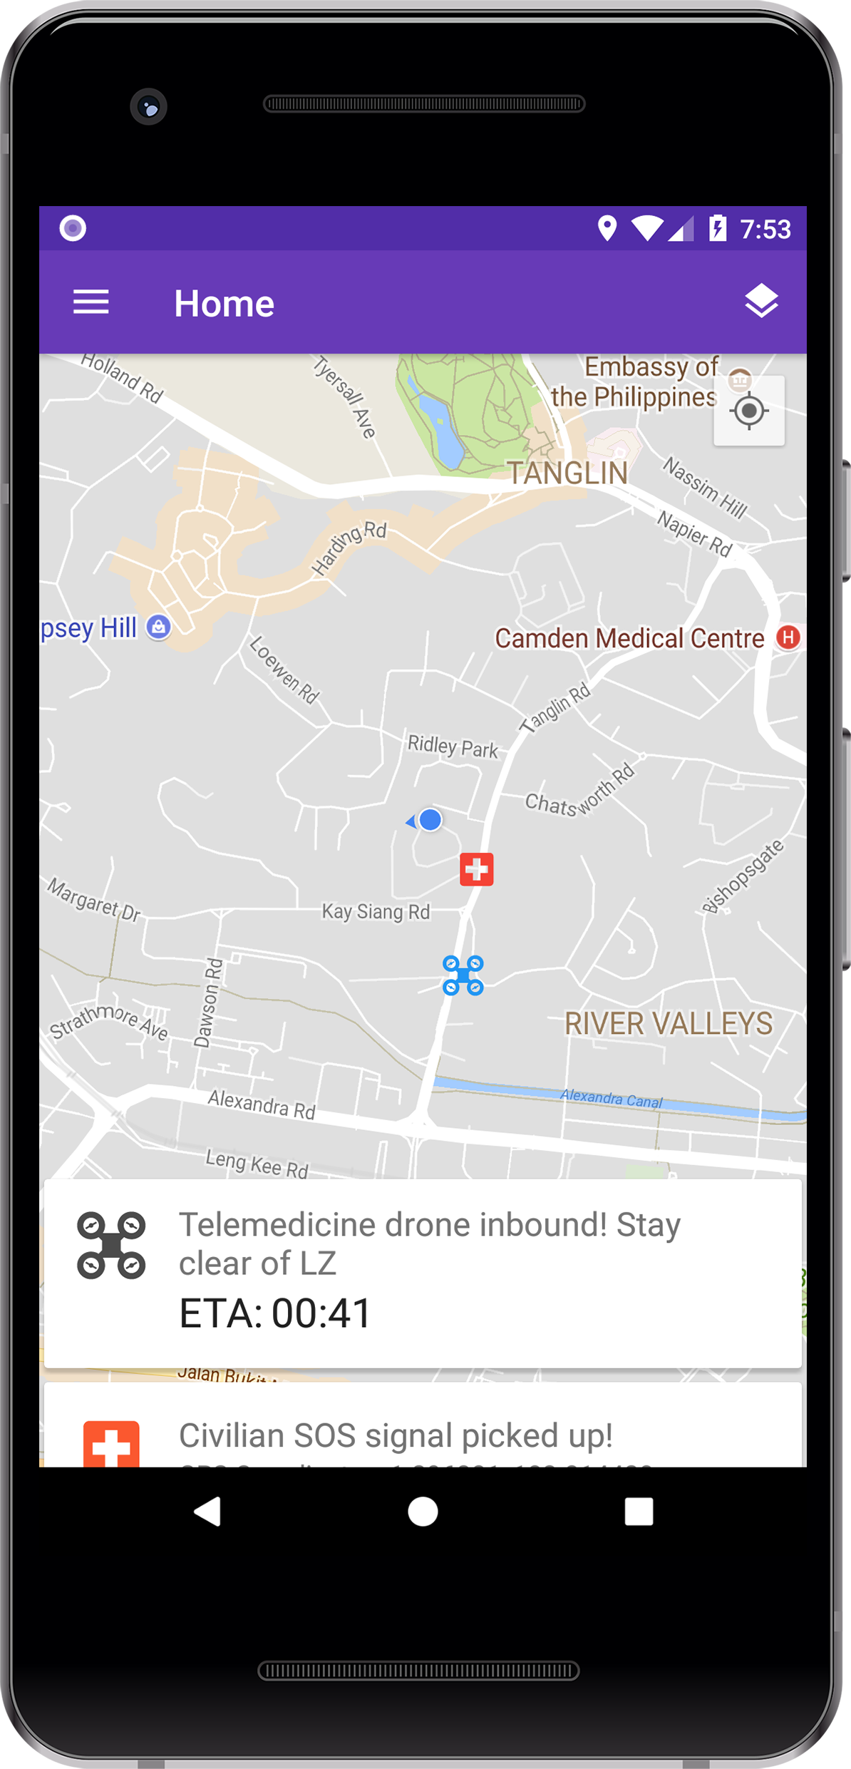
Notes:
The app was developed for two beneficiaries in mind, civilians and HADR workers.

Slide 5
Notes:
The Home screen for workers shows only crucial information they need to see now, providing instant situational awareness to every worker without any clutter.

Slide 6
Notes:
It provides location data on where the worker is, locations of victims through SOS calls, designated drone landing zones and…

Slide 7
Notes:
…organises all these information in scrollable cards at the bottom of the screen. These features are enabled by the Zephyr pseudo-satellite which provides some degree of Internet access to every worker in the area.

Slide 8
Notes:
In addition, the Home view provides a powerful way to visualise satellite imagery through the use of OpenCV, an open platform for computer image processing…

Slide 9
Notes:
…which is run directly on the phone itself.

Slide 10
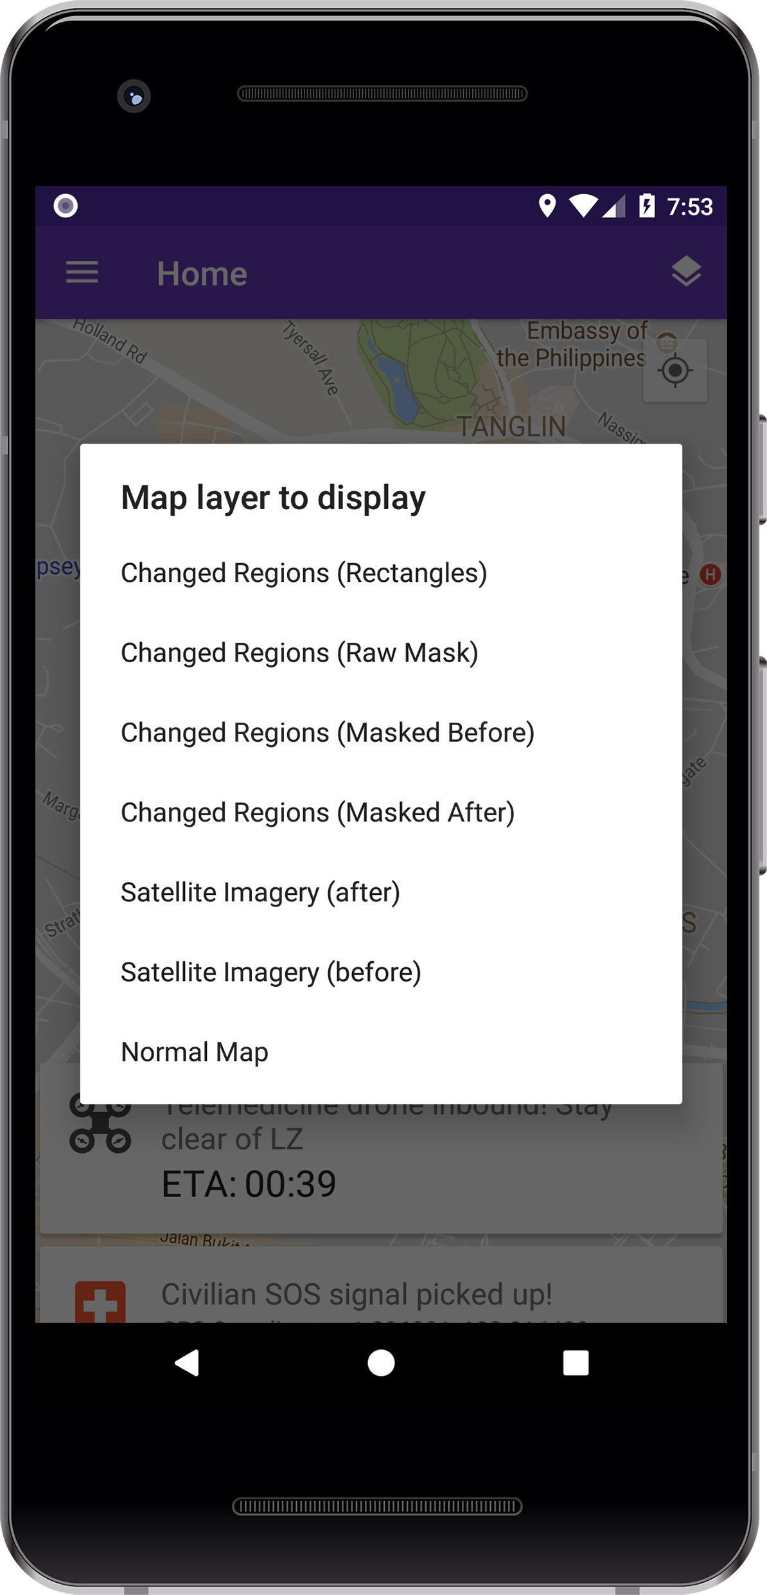
Notes:
The imagery used may come either from the Zephyr pseudo-satellite itself or from Earth imaging satellites which relays the data through Zephyr, that will be processed by the phone on-the-fly to obtain a map of changed regions.
Disasters change the landscape and topology of the area, removing easily identifiable landmarks and buildings.

Slide 11
Notes:
Our app provides seven different map options.

Slide 12
Notes:
While navigating by current satellite images may be more accurate, locals may be more comfortable navigating and providing directions by referencing past landmarks.

Slide 13
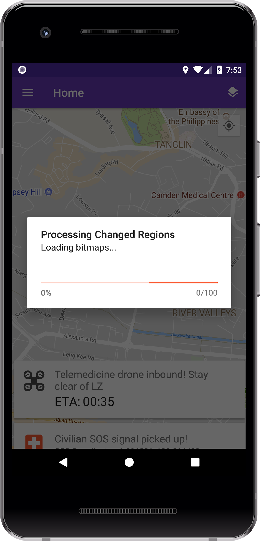
Notes:
Workers can also identify changes and adjust mission planning accordingly, for example, trucks can still drive over flooded roads, but not rivers.

Slide 14
Notes:
As all processing done locally, the only bandwidth required is to download new images from the Zephyr, resulting in low dependency on Internet connectivity. With a relatively modern Android device, the image processes in approximately 10 seconds, live on the phone.

Slide 15
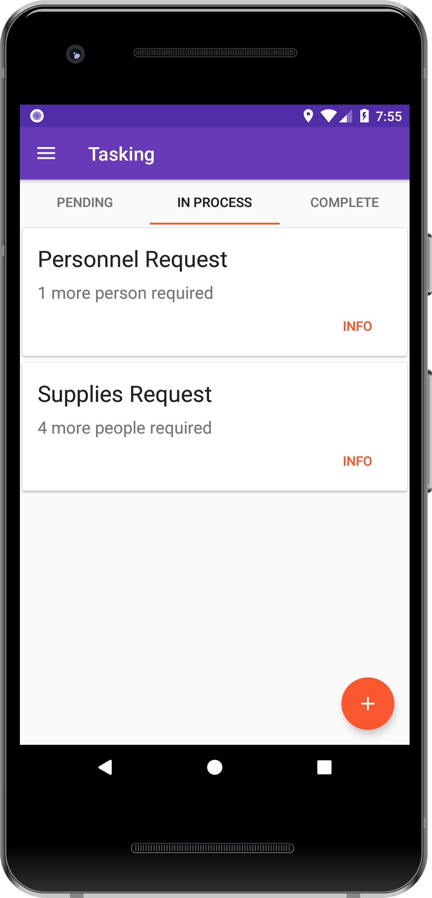
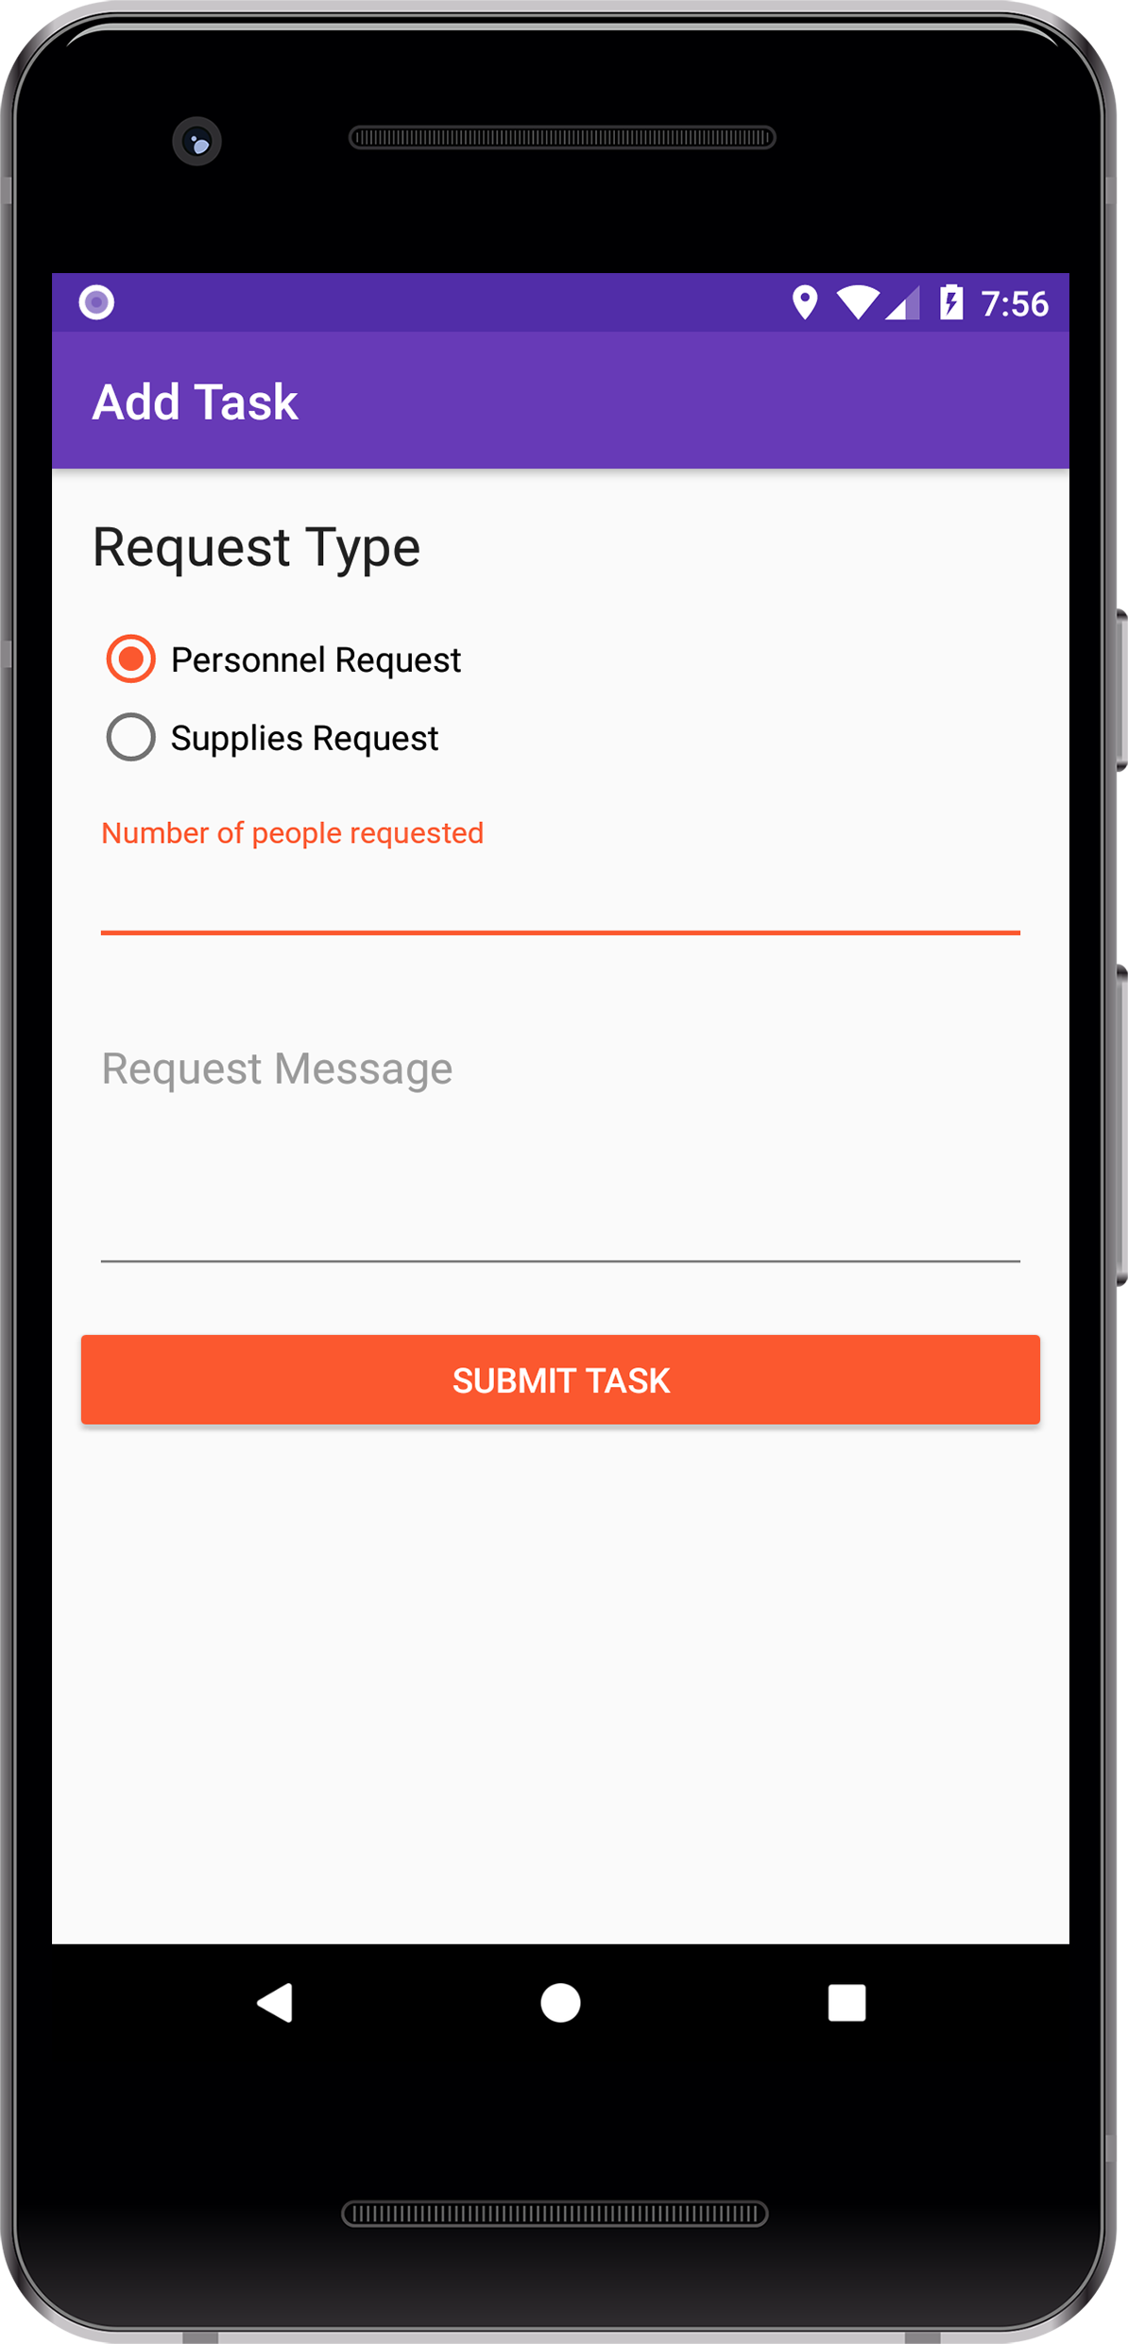
Notes:
The Tasking menu allows relief workers to request for additional manpower or supplies at their location and other workers can easily respond to the tasks. This system actively prevents manpower duplication by updating all workers on current job delegation, improving communication and allowing for more efficient movement of assets around the disaster zone.

Slide 16
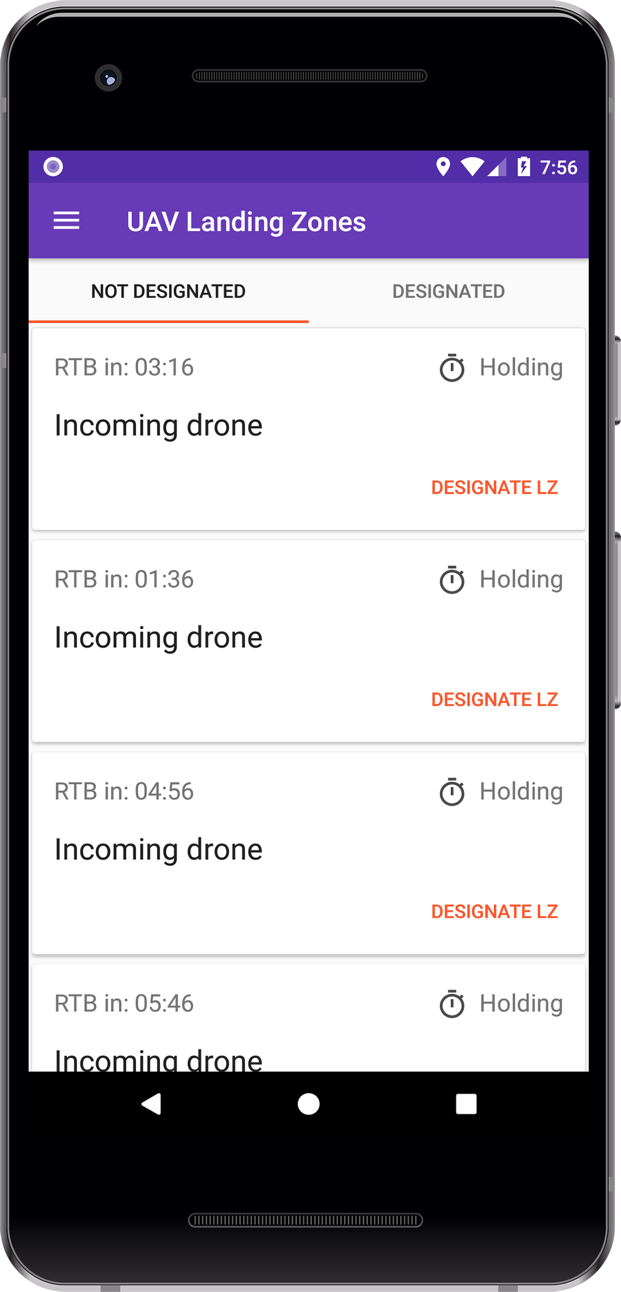
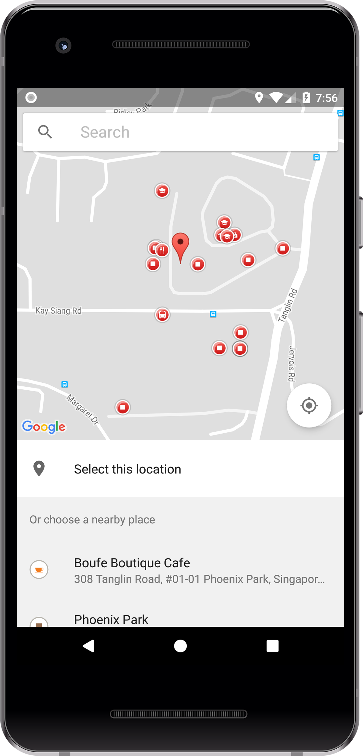
Notes:
The UAV Drone Fleet management system allows individual workers to request for telemedicine drones to be deployed to an exact location and gives them the flexibility to land the UAVs either at a known landmark or a custom set of GPS coordinates.

Slide 17
Notes:
When telemedicine drones are first sent to the disaster zone, they stay within holding areas until called upon by relief workers. In order to remain effective, drones will have to be sent back either for maintenance or restocking of material. The app will reflect this Return-To-Base timing of each individual drone.

Slide 18
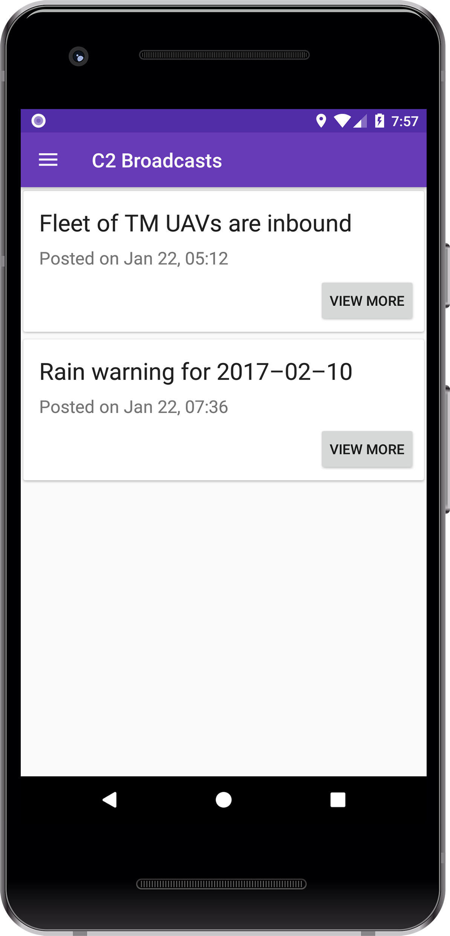
Notes:
An Internet-enabled C2 broadcasts menu enables every worker to receive updates directly from command and control centres and provides a means of communication between the C2 centre and individual workers. The updates could contain information such as hazardous weather, incoming drones or other information that requires the attention of all workers in the area.

Slide 19
One more thing…
Notes:
By now, you may have noticed that we have missed out one crucial functionality <NEXT>: the SOS call. Well that's because it is the "killer feature" of the entire app.

Slide 20
Notes:
This "crown jewel" of the application is mesh networking. As infrastructure could be severely damaged in a disaster area, enabling fast reestablishment of connection with the outside world is crucial for ensuring the survival of disaster victims during the “Golden Hours” of any SAR operation. In our app, we have designed a mesh network that automatically and transparently sets itself up without external intervention…

Slide 21
Notes:
…utilising the phone's pre-existing radios such as Wi-Fi and Bluetooth.

Slide 22
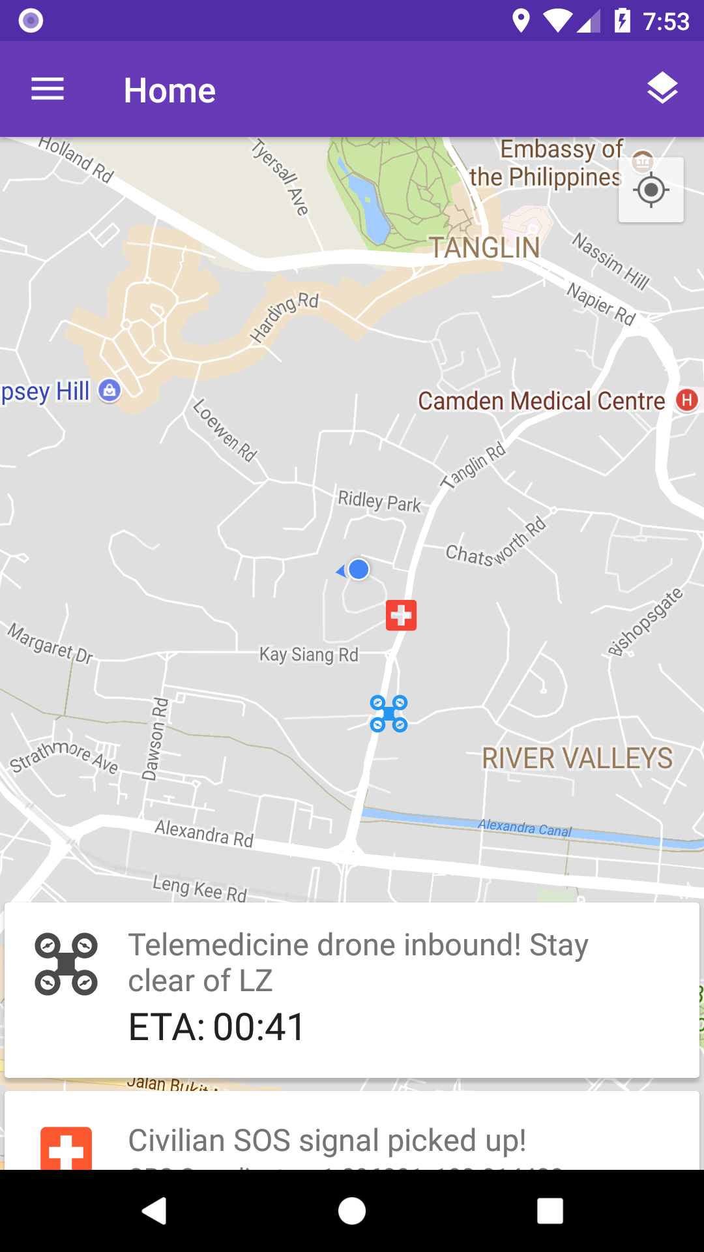
Notes:
A survivor in the disaster zone can easily send an SOS call containing a message and their GPS coordinates through either the Internet if it is still accessible, or through the mesh network that is automatically created by the workers' phones.
Such a mesh network significantly extends the range of communications compared to a traditional star topology whereby a central device, like a Wi-Fi router is needed.

Slide 23
Demo
Notes:
It’s time for the demo. I’ll hand my time over to Qian Zhe to demonstrate the app. <Press H to exit slides, Cmd-Tab to reenter slides> (Suggested to use Cmd-Tab instead to exit slides.)
You’re a relief worker. */Other phone sends SOS call/* You receive an SOS call from a survivor nearby. You immediately act upon this and */Goto Tasking/* requests for 3 more people to proceed to the location of the SOS call. You ask a local for directions to that place, however he gives them with reference to previous locations that have now been destroyed. */Goto Map Layers/* You use the map comparison function, which fetches fresh imagery from the Zephyr pseudosatellite and computes the differences, to find your way there.
At the location, you find that there are injured survivors */Goto UAV/* and you request for a telemedicine drone carrying first aid equipment. */Goto Designate UAV/* You declare a custom location 10 meters away as a new destination and submit the request.
*/Goto C2/* Just as the day is finished, you receive a C2 broadcast warning you of heavy rain that will happen soon in your area, prompting you to seek shelter for your safety.

Slide 24
Competition
Notes:
While there are other alternatives currently available, we believe that our app has a leg up on them because of 3 advantages:

Slide 25
Design
Notes:
Firstly, our app is designed to be non-reliant on technical literacy, meaning that our app is simple enough for almost anyone to use.

Slide 26

Zephyr Interoperability
Notes:
Secondly, the Zephyr Pseudo-Satellite interoperability feature allows for the app's usage even in areas by replacing damaged communications infrastructure with the Zephyr and allows for the Zephyr's sensors and camera to continuously update information in real time.

Slide 27
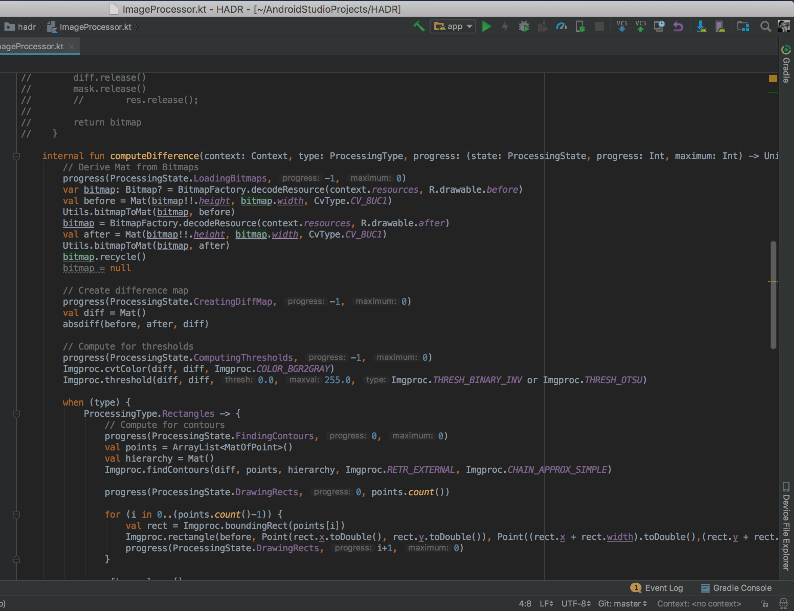
Open Source
Notes:
Lastly, the app is open source, meaning that technical experts can improve on the code and modify it to better suit a particular situation's needs. However we recognise that this could be a security concern, and we will only open source features of the app not related to security.

Slide 28

Future Plans
Notes:
In the future, we intend on expanding key features such as the mesh network to not only relay SOS messages but to also provide minimal internet access to an even larger area than the Zephyr can support.
Another feature we could add would be the ability for workers to report locations of interest such as identifying potentially dangerous areas that may not be visible on the satellite view map. An example of this would be fallen electrical lines still carrying live voltages.

Slide 29
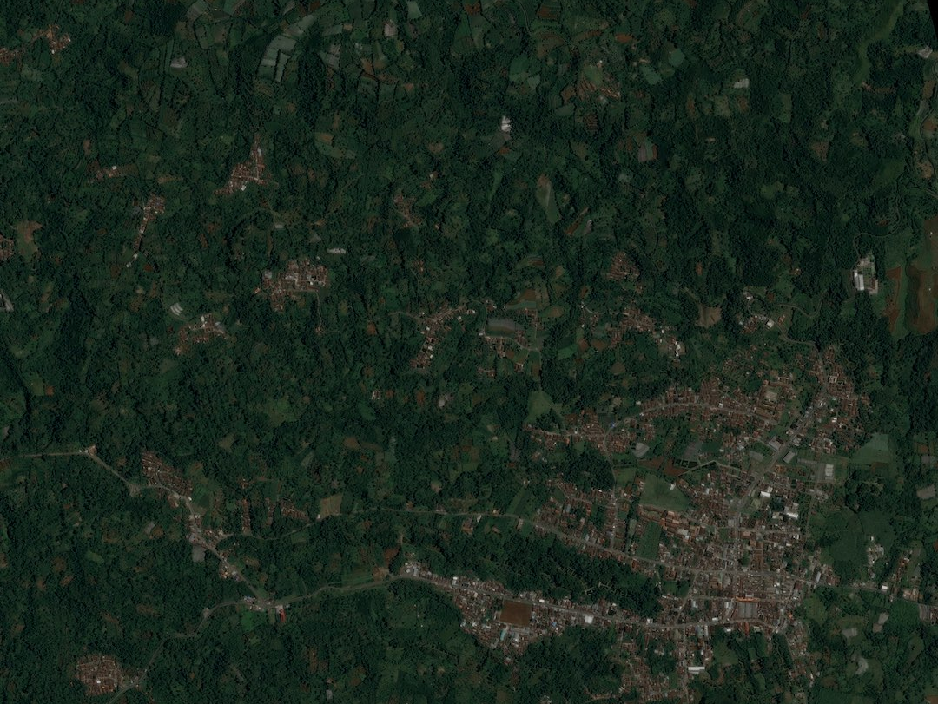
Conclusion
Notes:
In conclusion, our app provides the core essentials needed in a crisis: quick and clear communication even when support infrastructure has been destroyed, a way for the location of victims to be found, rapid deployment of manpower and material, and a logistic backbone to ensure efficient use of aid resources and workers. All these features are wrapped in an easy to use interface allowing for quick action in a crisis scenario where every minute counts.

